Slide 1
Differential Gene Expression After Wnt Treatments
Sean Fahey and Sakshi Pradhan

Slide 2
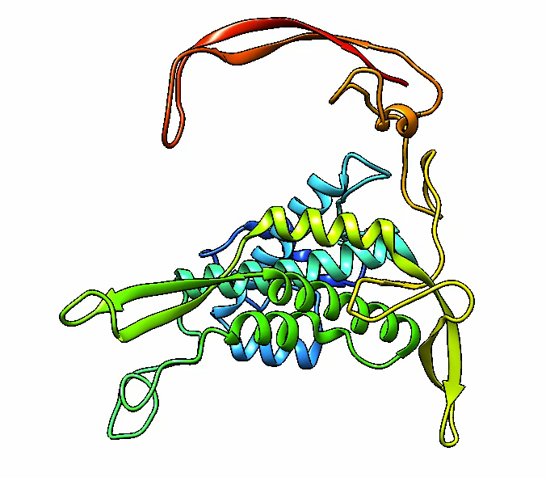
Background
Wnt family proteins
Major family of signaling molecules that influence many cell biological and developmental processes
Varied expression across all cell life stages (unlike growth factor signalers like FGF, TGFβ, etc.)
Complex PTMs
Less studied than other signaling peptides
Hypothesized to be involved in cancer
H1 cells
Human embryonic stem cell line (hESC)
Widely used
Crystal structure of Wnt3a
2.20 Å electron microscopy
RCSB PDB
Notes:
19 wnts
PTM: post translational modifications

Slide 3
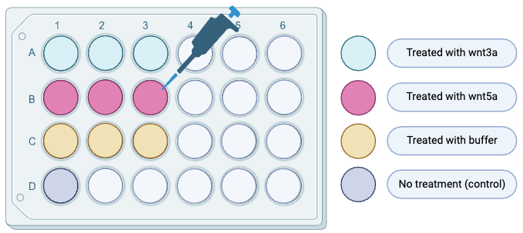
Methods - Experiment Design
H1 cells treated with the following:
Wnt3a
Wnt5a
Buffer
Control (no treatment)
DNA sequencing (template)
RNA sequencing (counts)

Slide 4
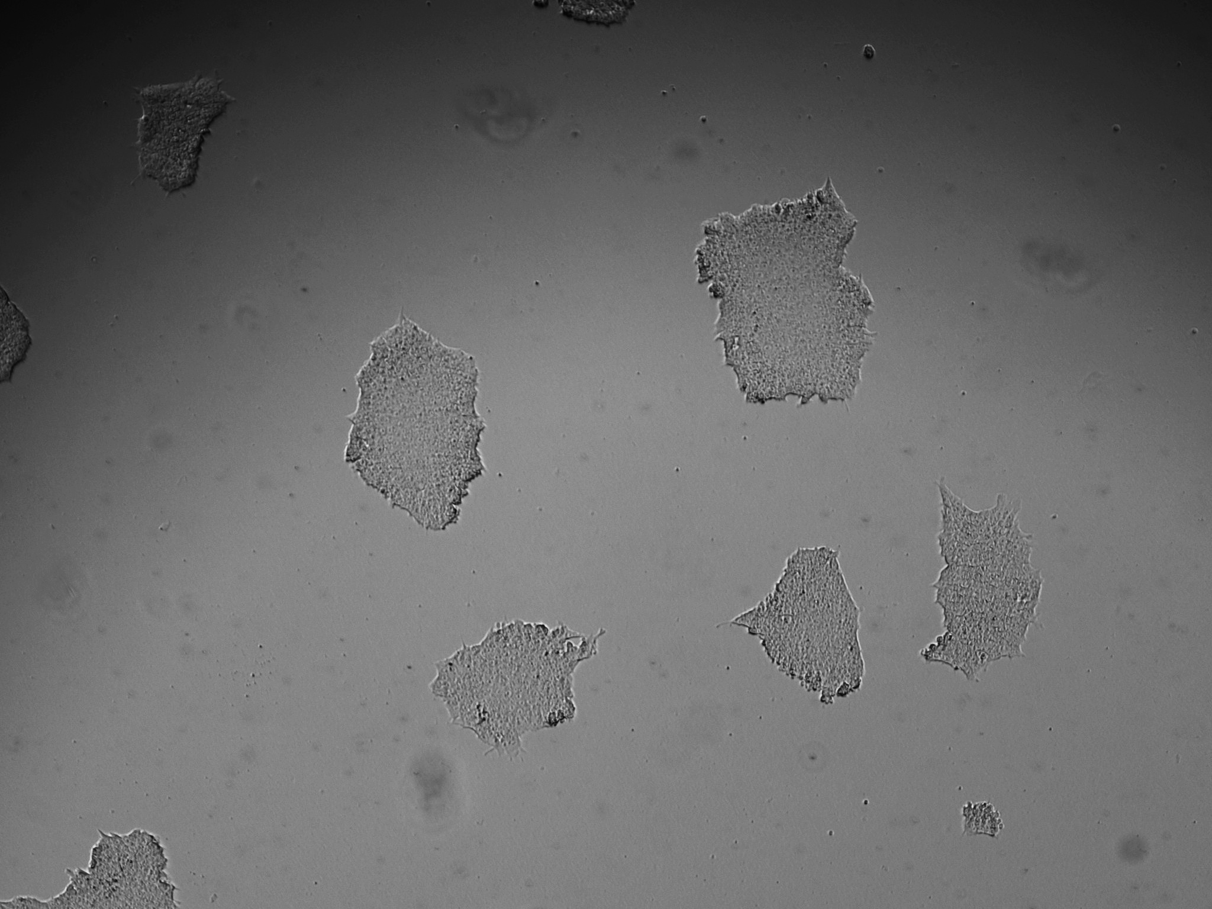
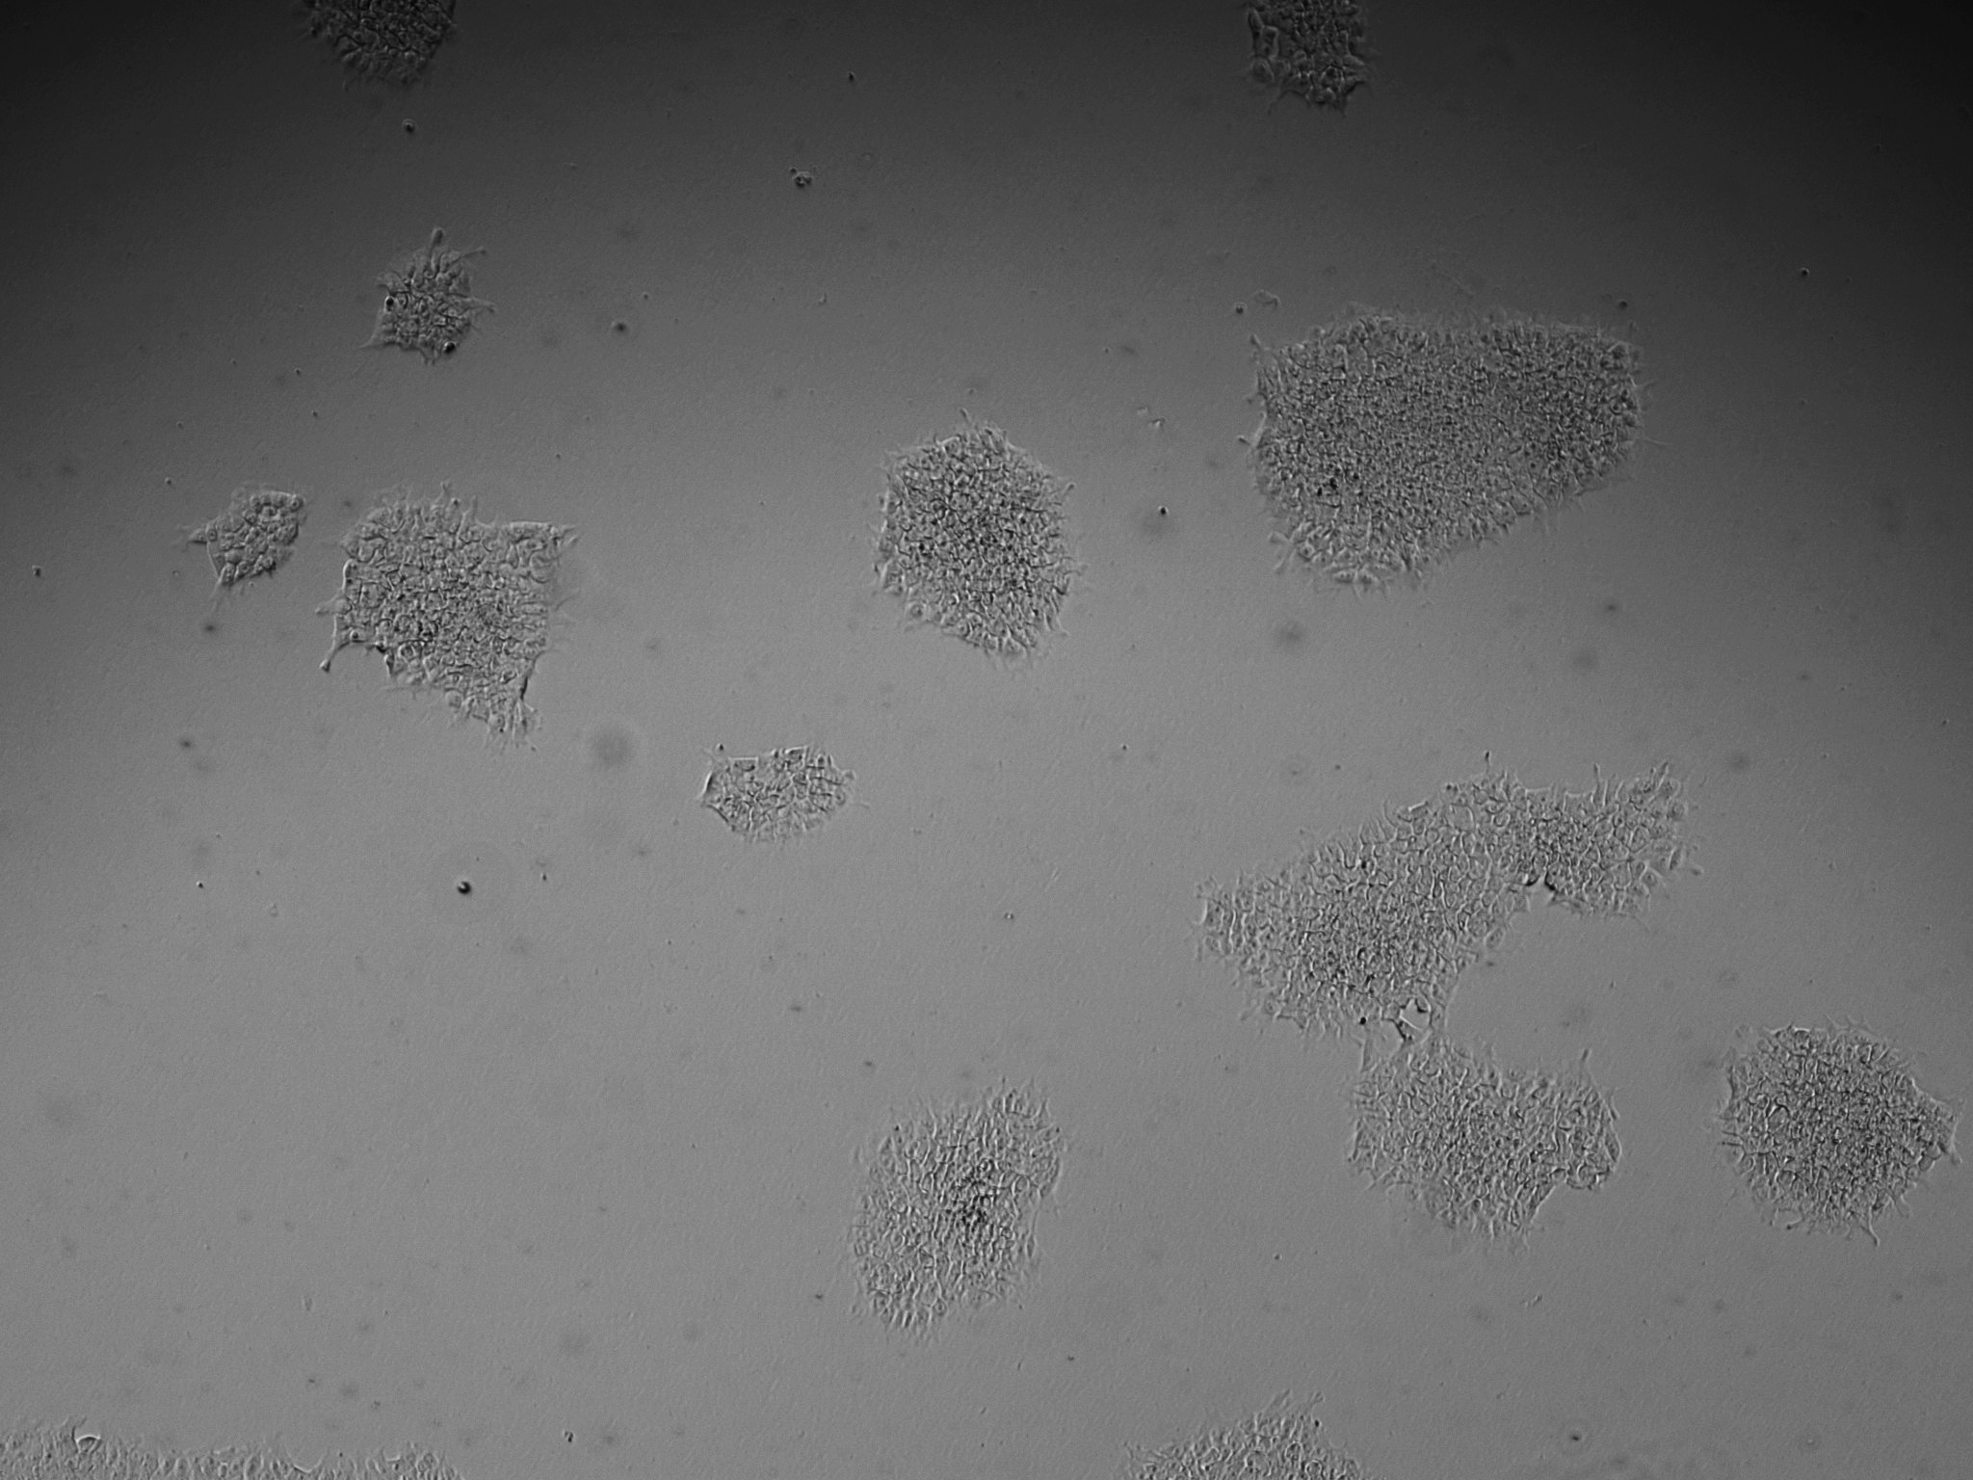
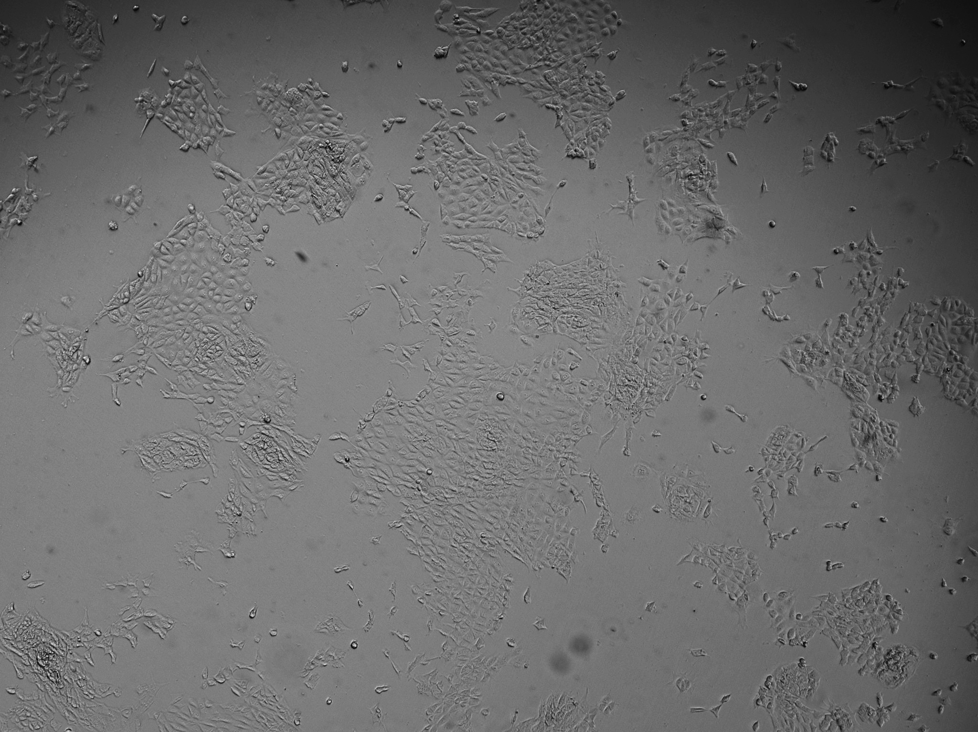
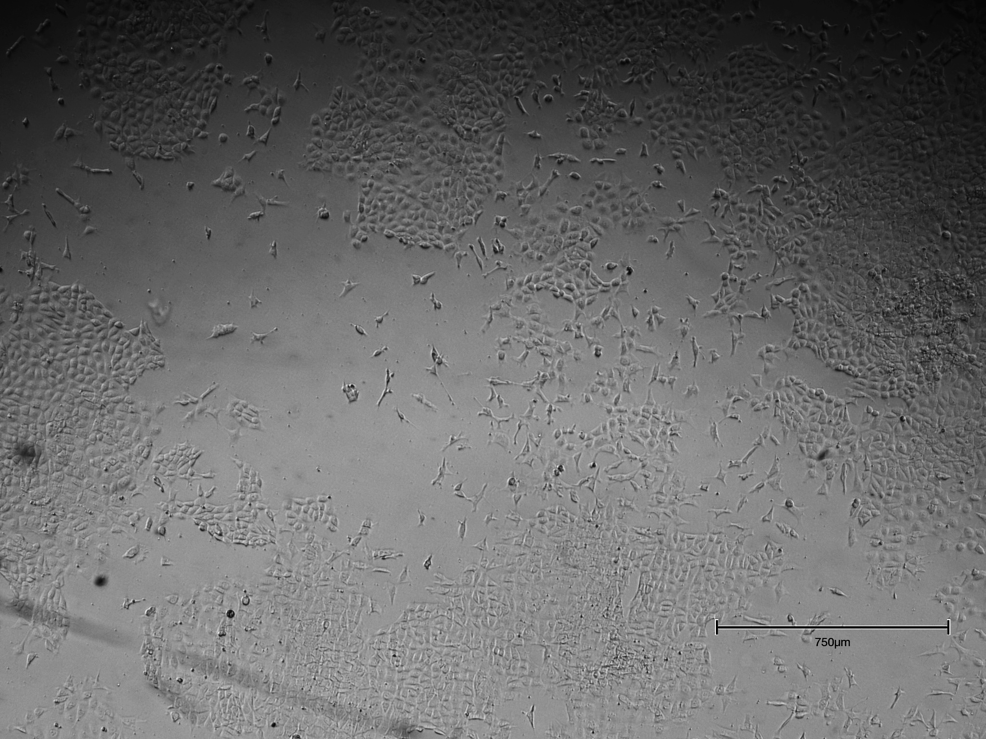
Methods - Experiment Design
No Treatment
24h WNT
H1 cells treated with the following:
Wnt3a
Wnt5a
Buffer
Control (no treatment)
DNA sequencing (template)
RNA sequencing (counts)
48h WNT
96h WNT

Slide 5
Methods – Statistics, Annotation, Plots
Short Read (Illumina) Sequencing
RNA count data
Perl
Differential expression for each treatment group
pandas
Calculate p-values
scipy.stats.ttest_ind
Bonferroni correction
statsmodels.stats.multitest.multipletests
Fetching NCBI gene name, description
Bio.Entrez.esearch
Bio.Entrez.efetch
Plots
plotly.graph_objects

Slide 6
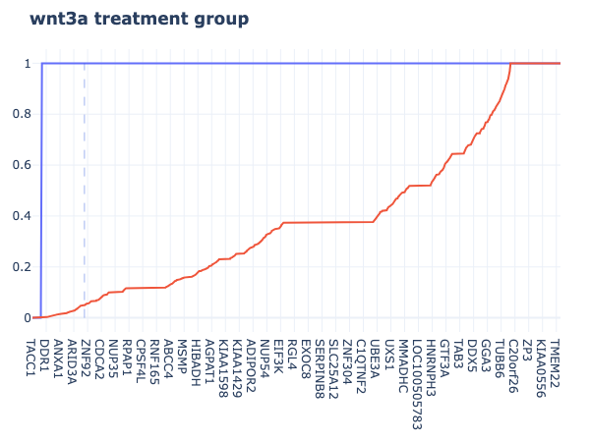
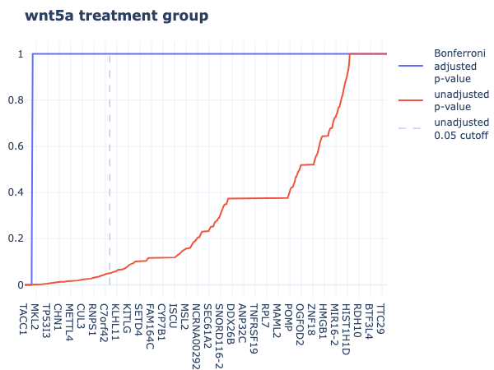
Results – p-values
Notes:
3a: 1256 -> 204
5a: 2994 -> 246

Slide 7
Results – 10 Most Differently Expressed
Gene Name | Gene Description | wnt3a | wnt5a
gastric cancer antigen Ga55 taxin-1 | This locus may represent a breast cancer candidate gene. It is located close to FGFR1 on a region of chromosome 8 that is amplified in some breast cancers. | Decrease | Increase
zinc finger protein 533 | Enables p53 binding activity. Involved in intrinsic apoptotic signaling pathway by p53 class mediator. Located in nucleus. | Decrease | Decrease
KIND domain-containing protein | The protein encoded by this gene is a Ras guanine nucleotide exchange factor that appears to negatively regulate dendritic growth in the brain. Knockdown of this gene in senescent umbilical vein endothelial cells partially reversed the senescence showing that this gene could potentially be targeted by anti-aging therapies. | Decrease | Decrease
synaptotagmin VI | The protein encoded by this gene belongs to the synaptotagmin family. Synaptotagmins share a common domain structure that includes a transmembrane domain and a cytoplasmic region composed of 2 C2 domains and are involved in calcium-dependent exocytosis of synaptic vesicles. This protein has been shown to be a key component of the secretory machinery involved in acrosomal exocytosis. | Increase | Increase
long intergenic non-protein coding RNA 294 |  | Increase | Increase
mitochondrial malate synthase | Enables (S)-citramalyl-CoA lyase activity; magnesium ion binding activity; and malate synthase activity. Involved in protein homotrimerization and regulation of cobalamin metabolic process. Predicted to be located in mitochondrion. | Increase | Increase
uncharacterized LOC143666 |  | Decrease | Decrease
protein phosphatase Mg2+/Mn2+ dependent 3B | Predicted to enable protein serine/threonine phosphatase activity. Predicted to be involved in signal transduction. Located in several cellular components including intercellular bridge; mitotic spindle; and nucleoplasm. | Increase | Increase
talin 2 | This gene encodes a protein related to talin 1, a cytoskeletal protein that plays a significant role in the assembly of actin filaments and in spreading and migration of various cell types, including fibroblasts and osteoclasts. | Increase | Increase
UBA6 divergent transcript |  | Decrease | Decrease

Slide 8
Results – 10 Most Differently Expressed
Gene Name | Gene Description | wnt3a | wnt5a
gastric cancer antigen Ga55 taxin-1 | This locus may represent a breast cancer candidate gene. It is located close to FGFR1 on a region of chromosome 8 that is amplified in some breast cancers. | Decrease | Increase
zinc finger protein 533 | Enables p53 binding activity. Involved in intrinsic apoptotic signaling pathway by p53 class mediator. Located in nucleus. | Decrease | Decrease
KIND domain-containing protein | The protein encoded by this gene is a Ras guanine nucleotide exchange factor that appears to negatively regulate dendritic growth in the brain. Knockdown of this gene in senescent umbilical vein endothelial cells partially reversed the senescence showing that this gene could potentially be targeted by anti-aging therapies. | Decrease | Decrease
synaptotagmin VI | The protein encoded by this gene belongs to the synaptotagmin family. Synaptotagmins share a common domain structure that includes a transmembrane domain and a cytoplasmic region composed of 2 C2 domains and are involved in calcium-dependent exocytosis of synaptic vesicles. This protein has been shown to be a key component of the secretory machinery involved in acrosomal exocytosis. | Increase | Increase
long intergenic non-protein coding RNA 294 |  | Increase | Increase
mitochondrial malate synthase | Enables (S)-citramalyl-CoA lyase activity; magnesium ion binding activity; and malate synthase activity. Involved in protein homotrimerization and regulation of cobalamin metabolic process. Predicted to be located in mitochondrion. | Increase | Increase
uncharacterized LOC143666 |  | Decrease | Decrease
protein phosphatase Mg2+/Mn2+ dependent 3B | Predicted to enable protein serine/threonine phosphatase activity. Predicted to be involved in signal transduction. Located in several cellular components including intercellular bridge; mitotic spindle; and nucleoplasm. | Increase | Increase
talin 2 | This gene encodes a protein related to talin 1, a cytoskeletal protein that plays a significant role in the assembly of actin filaments and in spreading and migration of various cell types, including fibroblasts and osteoclasts. | Increase | Increase
UBA6 divergent transcript |  | Decrease | Decrease

